Slide 1

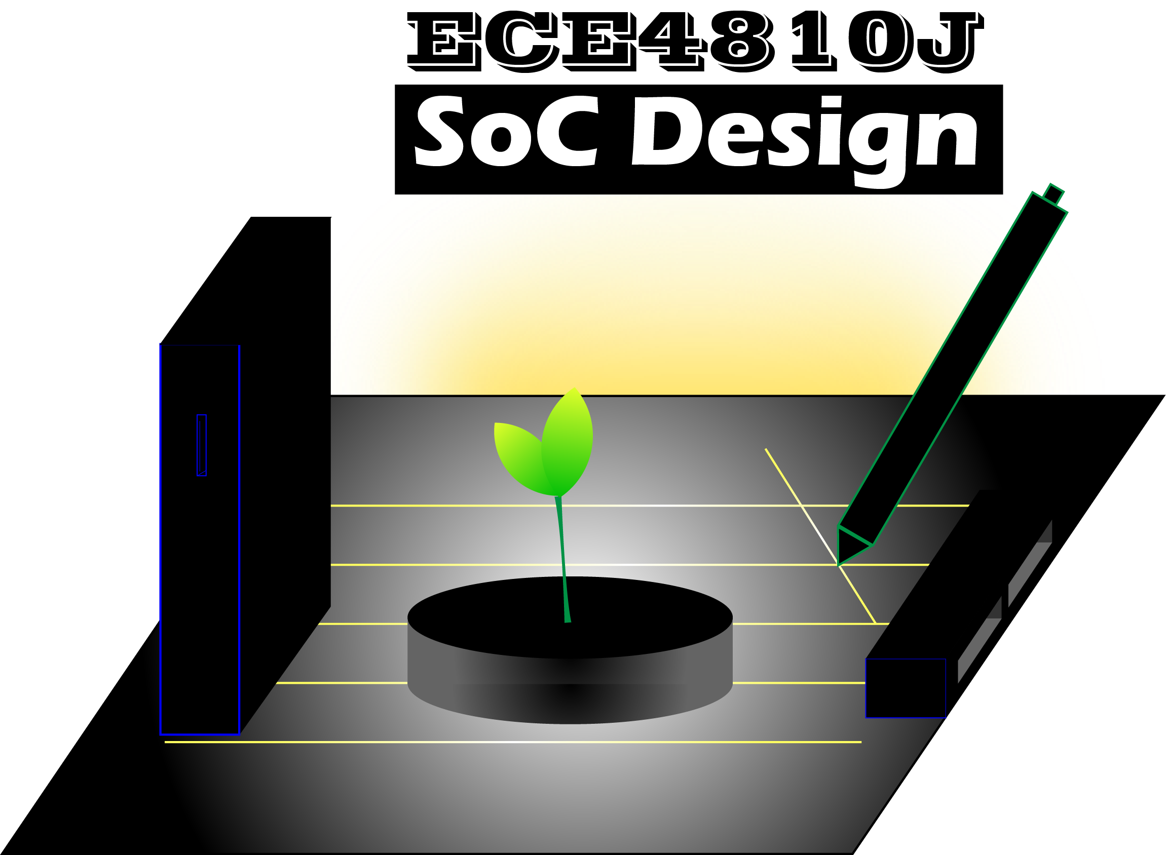
Lab #6
OpenROAD
ECE4810J System-on-Chip Design
Yihua Liu
UM-SJTU Joint Institute
ayka_tsuzuki@sjtu.edu.cn
Nov. 7, 2022

Slide 2
Overview
Overview
Motivation
Chip Design Flow
Design and Flow Preparation
Design Synthesis
Design Floorplanning
Design Placement
Clock Tree Synthesis (CTS)
Design Routing
Design Finish
Design Verification
GDS
OpenROAD-flow-scrips
Structure
Platform Configs vs. Design
Configs

Slide 3
Overview
Debugging Common Design Problems
Analyzing Your Design
Klayout
PyMTL3 Supplements
Reference

Slide 4

Motivation
Why should SoC designer and researchers care?
Extending algorithms and techniques to real hardware designs
More accurate design space exploration
Hands on experience for job opportunities
Why choose Open Source?
Easier collaboration using publicly available IP and kits
Reproducibility and Apples-to-Apples comparison of new implementations
Easily re-use publicly available flows, best practices, designs and IP cores
Support form the open-source community
Opportunities for free/sponsored tape-outs
FREE!
Notes:
Mixed modeling

Slide 5
Chip Design Flow
Design Specification and Algorithm
RTL Implementation and Simulation
Synthesis to Gate Level
Physical Implementation
Verification and Signoff
PDK
Design Libraries
Design
Synthesis
Physical Implementation
Verification
Layout
Tool A
Tool B
Tool C
RTL-to-GDS Flow
Notes:
Mixed modeling

Slide 6
Design and Flow Preparation
Design Preparation
RTL Files
Timing Constraints
Design Parameters
Flow Setup
EDA Tool Setup
Design selection
Process development kit
Standard cell libraries
PDK
Design Libraries
Design
Synthesis
Physical Implementation
Verification
Layout
Tool A
Tool B
Tool C
RTL-to-GDS Flow
RTL
Synthesis
Floorplan
Place
CTS
Route
Finish
Verification
GDS
Notes:
Mixed modeling

Slide 7
Design Synthesis
Synthesis transforms RTL to netlist
RTL Parsing and Design Elaboration
Generic Mapping
Generic Optimizations
Technology Mapping
Technology Driven Optimization
Constraint Checking / Adherence
OpenROAD flows leverages Yosys
x = a’bc + a’bc’
y = b’c’ + ab’ + ac
x = a’b
y = b’c’ + ac
INVX1SC(.A(a),.Z(U1));
AND2X1SC(.A(U1),.B(b),.Z(U55));
AND2X1SC(.A(U2),.B(U3),.Z(U23));
ORX1SC(.A(U23),.B(U21),.Z(y));
RTL
Synthesis
Floorplan
Place
CTS
Route
Finish
Verification
GDS
Notes:
Mixed modeling

Slide 8
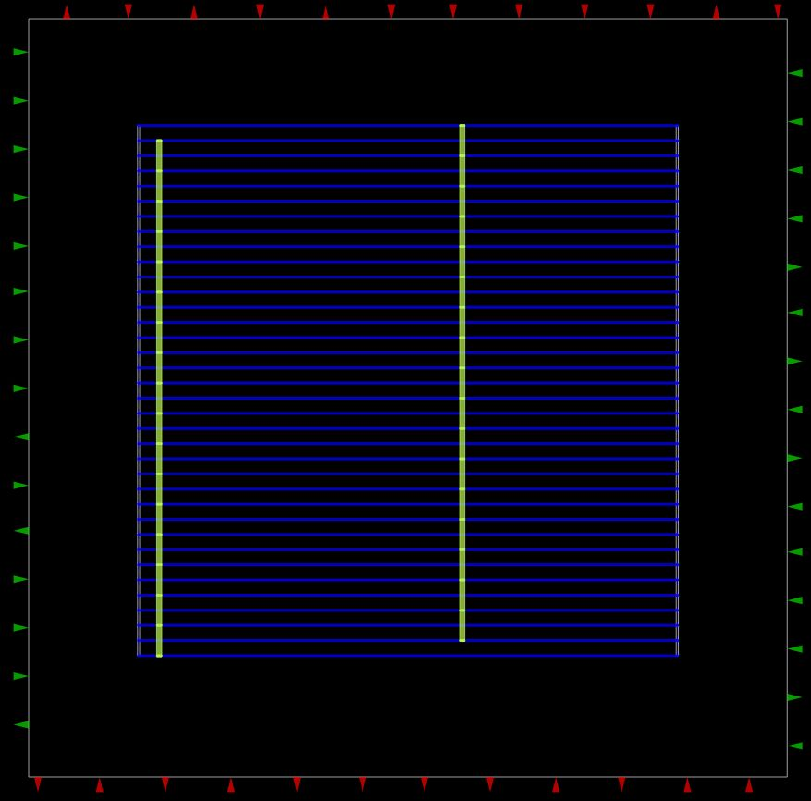
Design Floorplanning
ASIC Fundamentals
Standard Cells
Standard Cell Rows
Metal Stack
Power Grid
Macros
Design Specific
Setting Die Area
Assigning pin locations
Placing hard macros
Placing “guides” for cell placement
RTL
Synthesis
Floorplan
Place
CTS
Route
Finish
Verification
GDS
Notes:
Mixed modeling

Slide 9
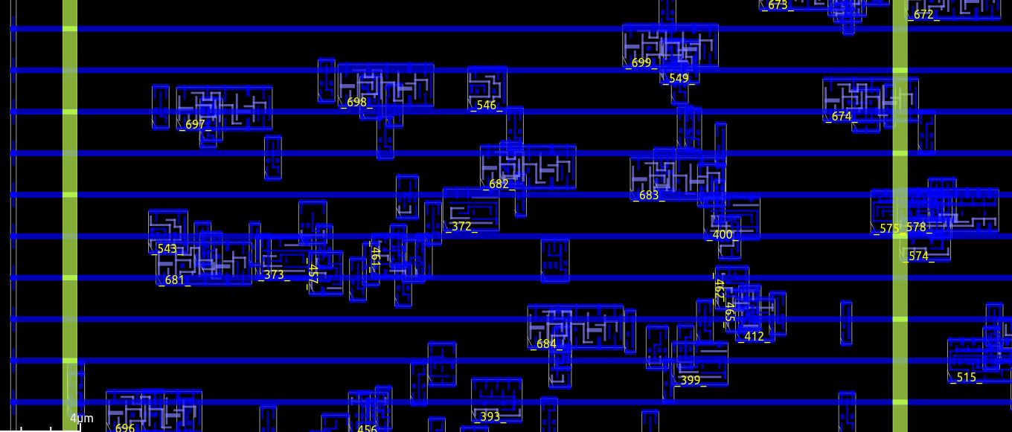
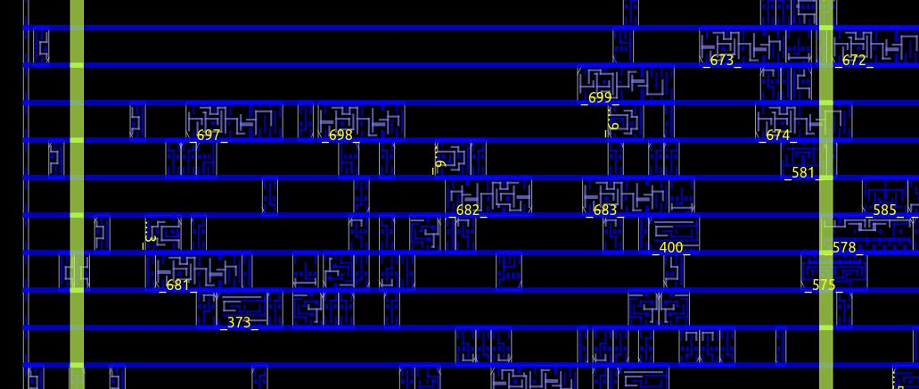
Design Placement
Global Placement
Minimize congestion and log wires
Placement Optimizations
Resizing
Buffering
Detail Placement
Overlap
Orientation
RTL
Synthesis
Floorplan
Place
CTS
Route
Finish
Verification
GDS
Notes:
Mixed modeling

Slide 10
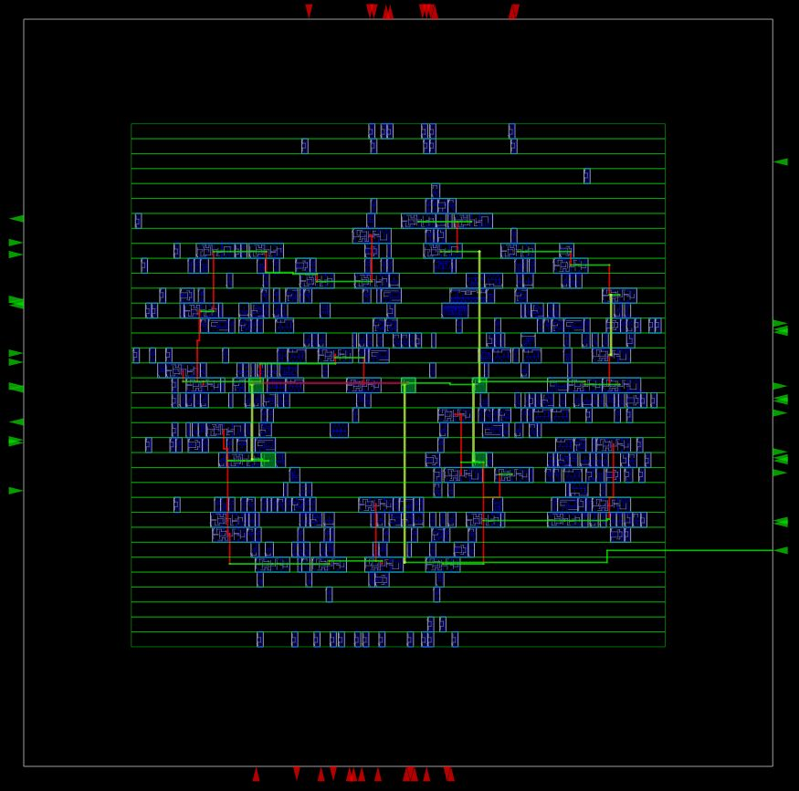
Clock Tree Synthesis (CTS)
Clock trees are built and buffered
Reducing Skew (setup/hold time)
Inserting buffers for high fanout signals
RTL
Synthesis
Floorplan
Place
CTS
Route
Finish
Verification
GDS
Notes:
Mixed modeling

Slide 11
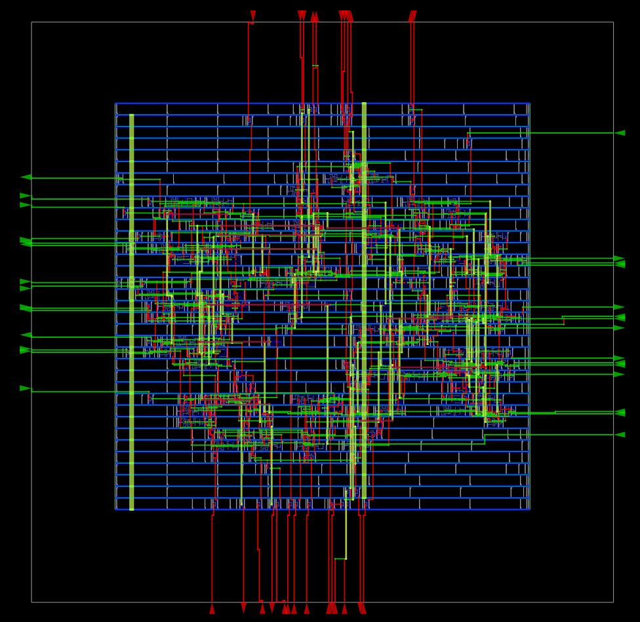
Design Routing
Global Routing
Detail Routing
Routing optimization/fixing
RTL
Synthesis
Floorplan
Place
CTS
Route
Finish
Verification
GDS
Notes:
Mixed modeling

Slide 12
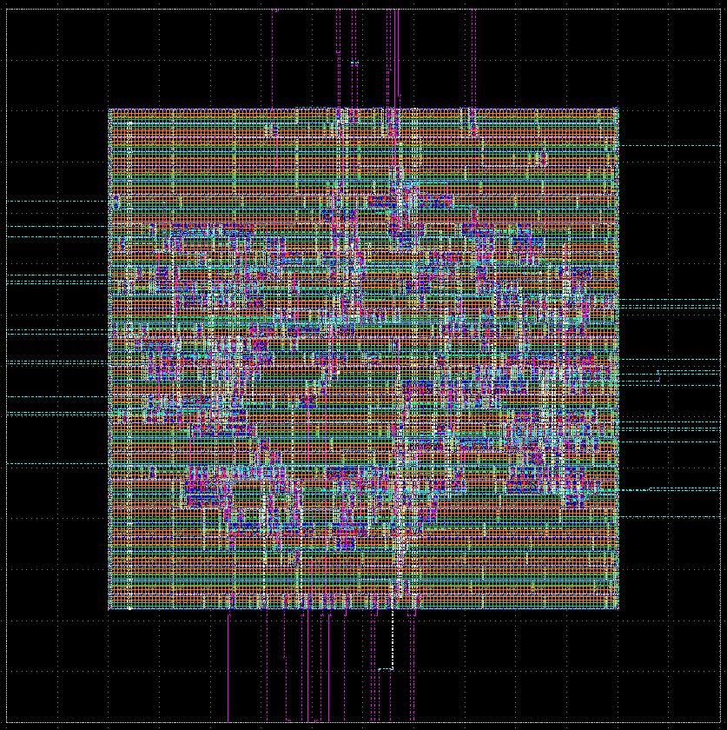

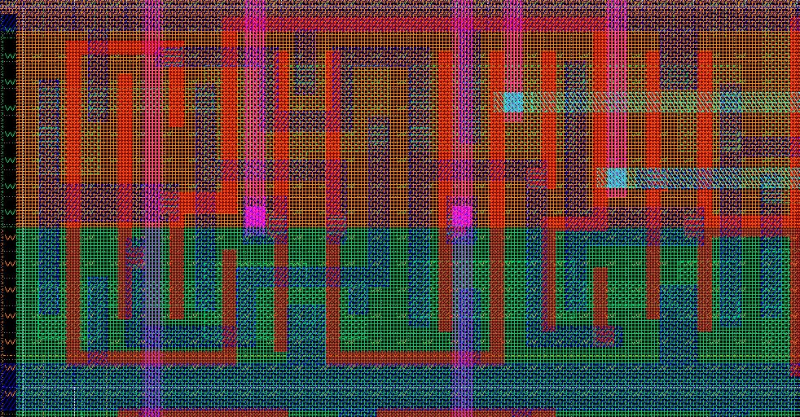
Design Finish
Parasitic extraction
Timing Signoff
Dummy Metal Fill
Export
Layout (GDS)
Netlist (Verilog)
Reports
KLayout for GDS Export and Viewing
RTL
Synthesis
Floorplan
Place
CTS
Route
Finish
Verification
GDS
Notes:
Mixed modeling

Slide 13

Design Verification
Design Rule Check (DRC)
Layout vs Schematic (LVS)
Back-annotated Simulations
RTL
Synthesis
Floorplan
Place
CTS
Route
Finish
Verification
GDS
Notes:
Mixed modeling

Slide 14

GDS
Ready to send to fab!
RTL
Synthesis
Floorplan
Place
CTS
Route
Finish
Verification
GDS
Notes:
Mixed modeling

Slide 15
OpenROAD-flow-scripts Structure
OpenROAD-flow-scripts/
|—— docker
|—— flow
|—— |—— designs
|—— |—— platforms
|—— |—— scripts
|—— |—— test
|—— |—— tutorials
|—— |—— util
|—— jenkins
|—— tools
Flow repository
Dockerfiles (containerization)
Flow – everything happens here!
Source RTL, configs, constraints for sample designs
Platform data (.lib, .lef, .gds, etc.), configs
Tcl scripts for OpenROAD, yosys
Test scripts and run directory
Tutorials (WIP)
Utility scripts (package issues, collect data, other misc.
Continuous integration (CI)
OpenROAD, yosys source repos; binaries
Notes:
Mixed modeling

Slide 16
Platform Configs vs. Design Configs
export TECH_LEF = …
export SC_LEF = …
export LIB_FILES = …
export GDS_FILES = …
export CELL_PAD_IN_SITES_GLOBAL_PLACEMENT ?= …
export CELL_PAD_IN_SITES_DETAIL_PLACEMENT ?= …
export PLACE_DENSITY ?= …
|—— platforms
| |——— [PLATFORM]
| | |—— config.mk
|—— designs
|——— [PLATFORM]
|—— config.mk
Technology files
export DESIGN_NAME = …
export PLATFORM = …
export VERILOG_FILES = …
export SDC_FILE = …
export DIE_AREA = …
export CORE_AREA = …
export PLACE_DENSITY = …
Good default parameters
Design files
Parameter overrides
Notes:
Mixed modeling

Slide 17
Debugging Common Design Problems
Notes:
Mixed modeling

Slide 18
What Do Messages Mean?
INFO: Report data, status, or current progress
WARNING: Unexpected situation, but tools will do best to continue
Designer should fix warnings or validate they are benign
ERROR: Unexpected situation, tools cannot work around issue
CRIT: openroad must exit immediately (rare)
All segfaults / asserts / crashes are bugs :)
Notes:
Mixed modeling

Slide 19
Debugging Strategy
Review error which caused flow to abort
Check warnings and errors starting from beginning of flow
Early warnings can be cause of later errors
Try to identify root cause of issue
Design problem?
Tool problem?
Unrealistic expectations?
Notes:
Mixed modeling

Slide 20
Common Problems and Solutions
Utilization too high - fails placement
Increase die area or decrease core utilization
Utilization too high - fails resizing
Check for proper SDC constraints
Check that user-generated macros have reasonable constraints (e.g. good .lib files)
Congestion too high - fails global routing
Try previous fixes
Try decreasing layer adjustment
Congestion too high - fails detail routing
Try previous fixes
Try adding cell padding to space cells further apart
If violations always occur on same cell(s), try marking those cells as dont_use
Design too small - fails PDN generation
Try increasing design size or reducing power grid pitch
Notes:
Mixed modeling

Slide 21
Common Problems and Solutions
Design runtime too long
Increase utilization if too low
Relax timing constraints
Reduce design complexity
Faster machine :)
Failing setup time
Hard problem - may just need to reduce constraints
Change architecture: more pipelining, reduce complexity
Failing hold time
Check that user cells (e.g. SRAM) are properly constrained
Check design constraints are valid (SDC)
Designs with multiple clocks are tricky!
Check that your PDK has properly correlated parasitics
Notes:
Mixed modeling

Slide 22
Analyzing Your Design
Notes:
Mixed modeling

Slide 23
Reporting Chip Metrics – Area
Different area numbers mean different things
Some metrics assume 100% utilization – 70-90% more typical
Buffering and clock tree can add significant area (20%+)
Chip I/O (pad rings, etc.) & fab markers (fiducials, etc.) rarely accounted for
Test interfaces can add significant area too!
 | Logic | SRAM | Buffers | Clock tree | Chip I/O | Fab Markers | Unutilized Space
Synthesized | √ | √ | Some | × | Usually no | × | ×
Places & Routed | √ | √ | √ | √ | Usually no | × | ×
“Die area” | √ | √ | √ | √ | Sometimes | Usually no | √
“Die size” | √ | √ | √ | √ | √ | √ | √
Notes:
Mixed modeling

Slide 24
Reporting Chip Metrics – Power
Buffers and clock tree consume significant power (40%+)
Chip I/O can be simulated but usually isn’t
Simulation type makes a huge difference!
Activity factor vs. switching activity (SAIF) vs. vector (VCD)
 | Logic | SRAM | Buffers | Clock tree | Chip I/O | Supply losses
Synthesized | √ | √ | Some | × | Usually no | ×
Places & Routed | √ | √ | √ | √ | Usually no | ×
“Die area” | √ | √ | √ | √ | Sometimes | ×
“Die size” | √ | √ | √ | √ | √ | √
Notes:
Mixed modeling

Slide 25
Reporting Chip Metrics – Frequency
Classic synthesis can provide mediocre/poor estimates of real chip frequency
Physical synthesis provides much better estimates
Place & route offers excellent estimates
Typical, best, worst, and other modeling corners
Real chips have a distribution of frequencies and are binned
 | Parasitics model | Gate timing model | Clock tree model
Synthesized | Wire-load | Usually “typical corner” | Ideal
Places & Routed | Estimated | Usually “typical corner” | Estimated
“Die area” | Extracted | Usually “typical corner” | Extracted
“Die size” | Binned
Notes:
Mixed modeling

Slide 26
Limitations and Future Directions
Notes:
Mixed modeling

Slide 27
OpenROAD Roadmap – Active Projects
Ease of use
Simplify install process
Broaden OS support
Python API, Python module
Documentation improvements
Improved support
Support and tune additional PDKs
Support additional technology rules
Enhanced features
Hierarchical implementation
Universal Power Format (UPF) support
Maintenance
Code cleanup and optimization
Notes:
Mixed modeling

Slide 28
OpenROAD Roadmap – Long-term Projects
Enhanced Features
Vector-based power calculation
CCS timing engine
Incremental implementation
COPILOT: >100x improvement to tool throughput
Massively distributed workloads
ML-based EDA
Interfaces for data collection
ML-guided optimization
Education and outreach
Courses, tutorials, and more!
Notes:
Mixed modeling

Slide 29
OpenROAD Limitations
Ease of use
Mediocre support for SystemVerilog (yosys)
Lack of design checking / sanity checking
Quality of Results
No multi-Vt flow yet
No automatic clock gating yet
Lacking quality hierarchical implementation
Slow runtime on large designs
Design features
Hierarchical extraction accuracy is limited
Analog / mixed signal support is very preliminary
Notes:
Mixed modeling

Slide 30
OpenROAD Advantages
Accessibility
No license limitations / license servers!
Run 100s of OpenROAD instances for free
Access to source code for debugging / modification
Share and get help with tool questions (no paywalls)
Active community
Updates nearly daily
Issues fixed and upstreamed in days, not months
Pull requests accepted for any useful fixes / features
Reproducibility
Easy to package designs and reproduce exactly
Able to validate other’s research
Notes:
Mixed modeling

Slide 31

OpenLane vs. OpenROAD-flow-scripts
Based off OpenRoad, yosys
Support only for sky130
Focus full-chip open-source signoff for sky130
Tcl-based flow
Only supports Docker
Maintained by Efabless
Based off OpenRoad, yosys
Support for several PDKs
Focus on full-chip closed-source signoff
Make-based flow
Supports Docker, native execution
Maintained by OpenROAD team
Notes:
Mixed modeling

Slide 32
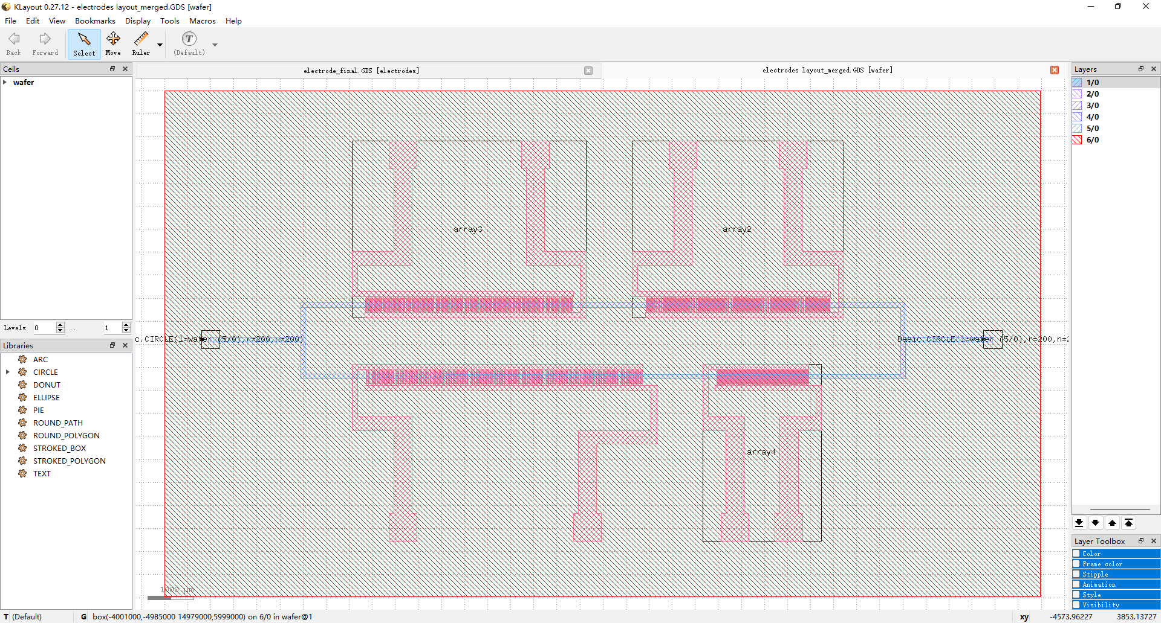
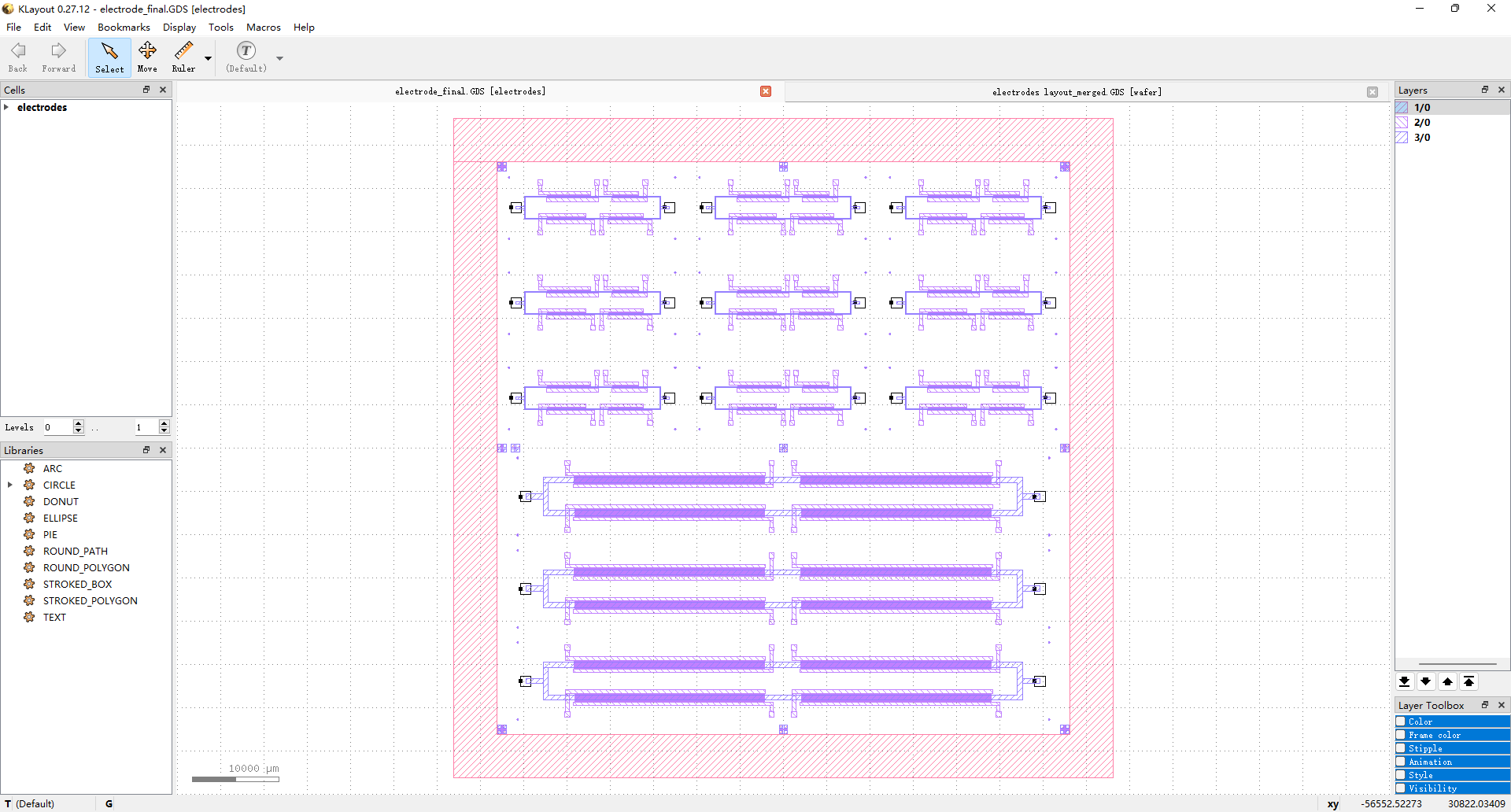
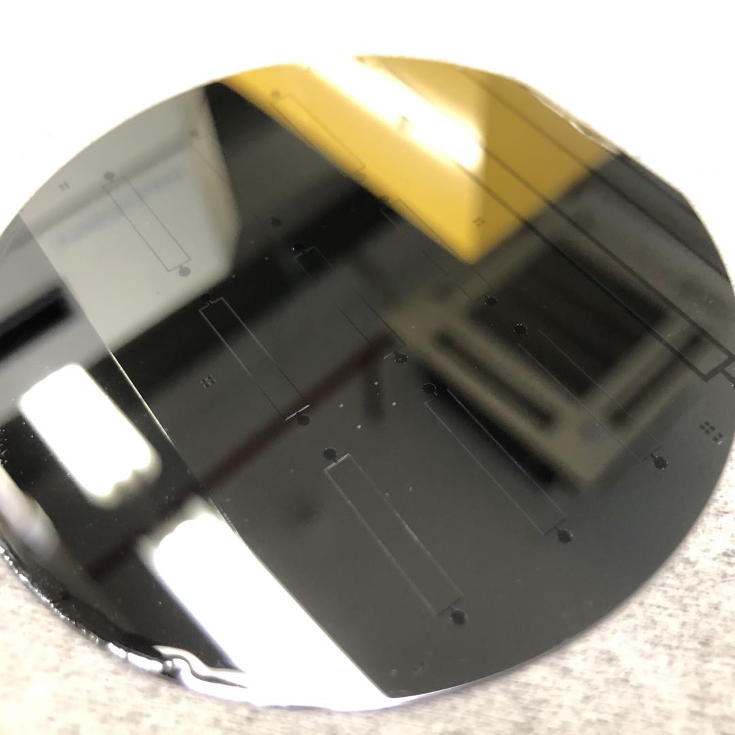
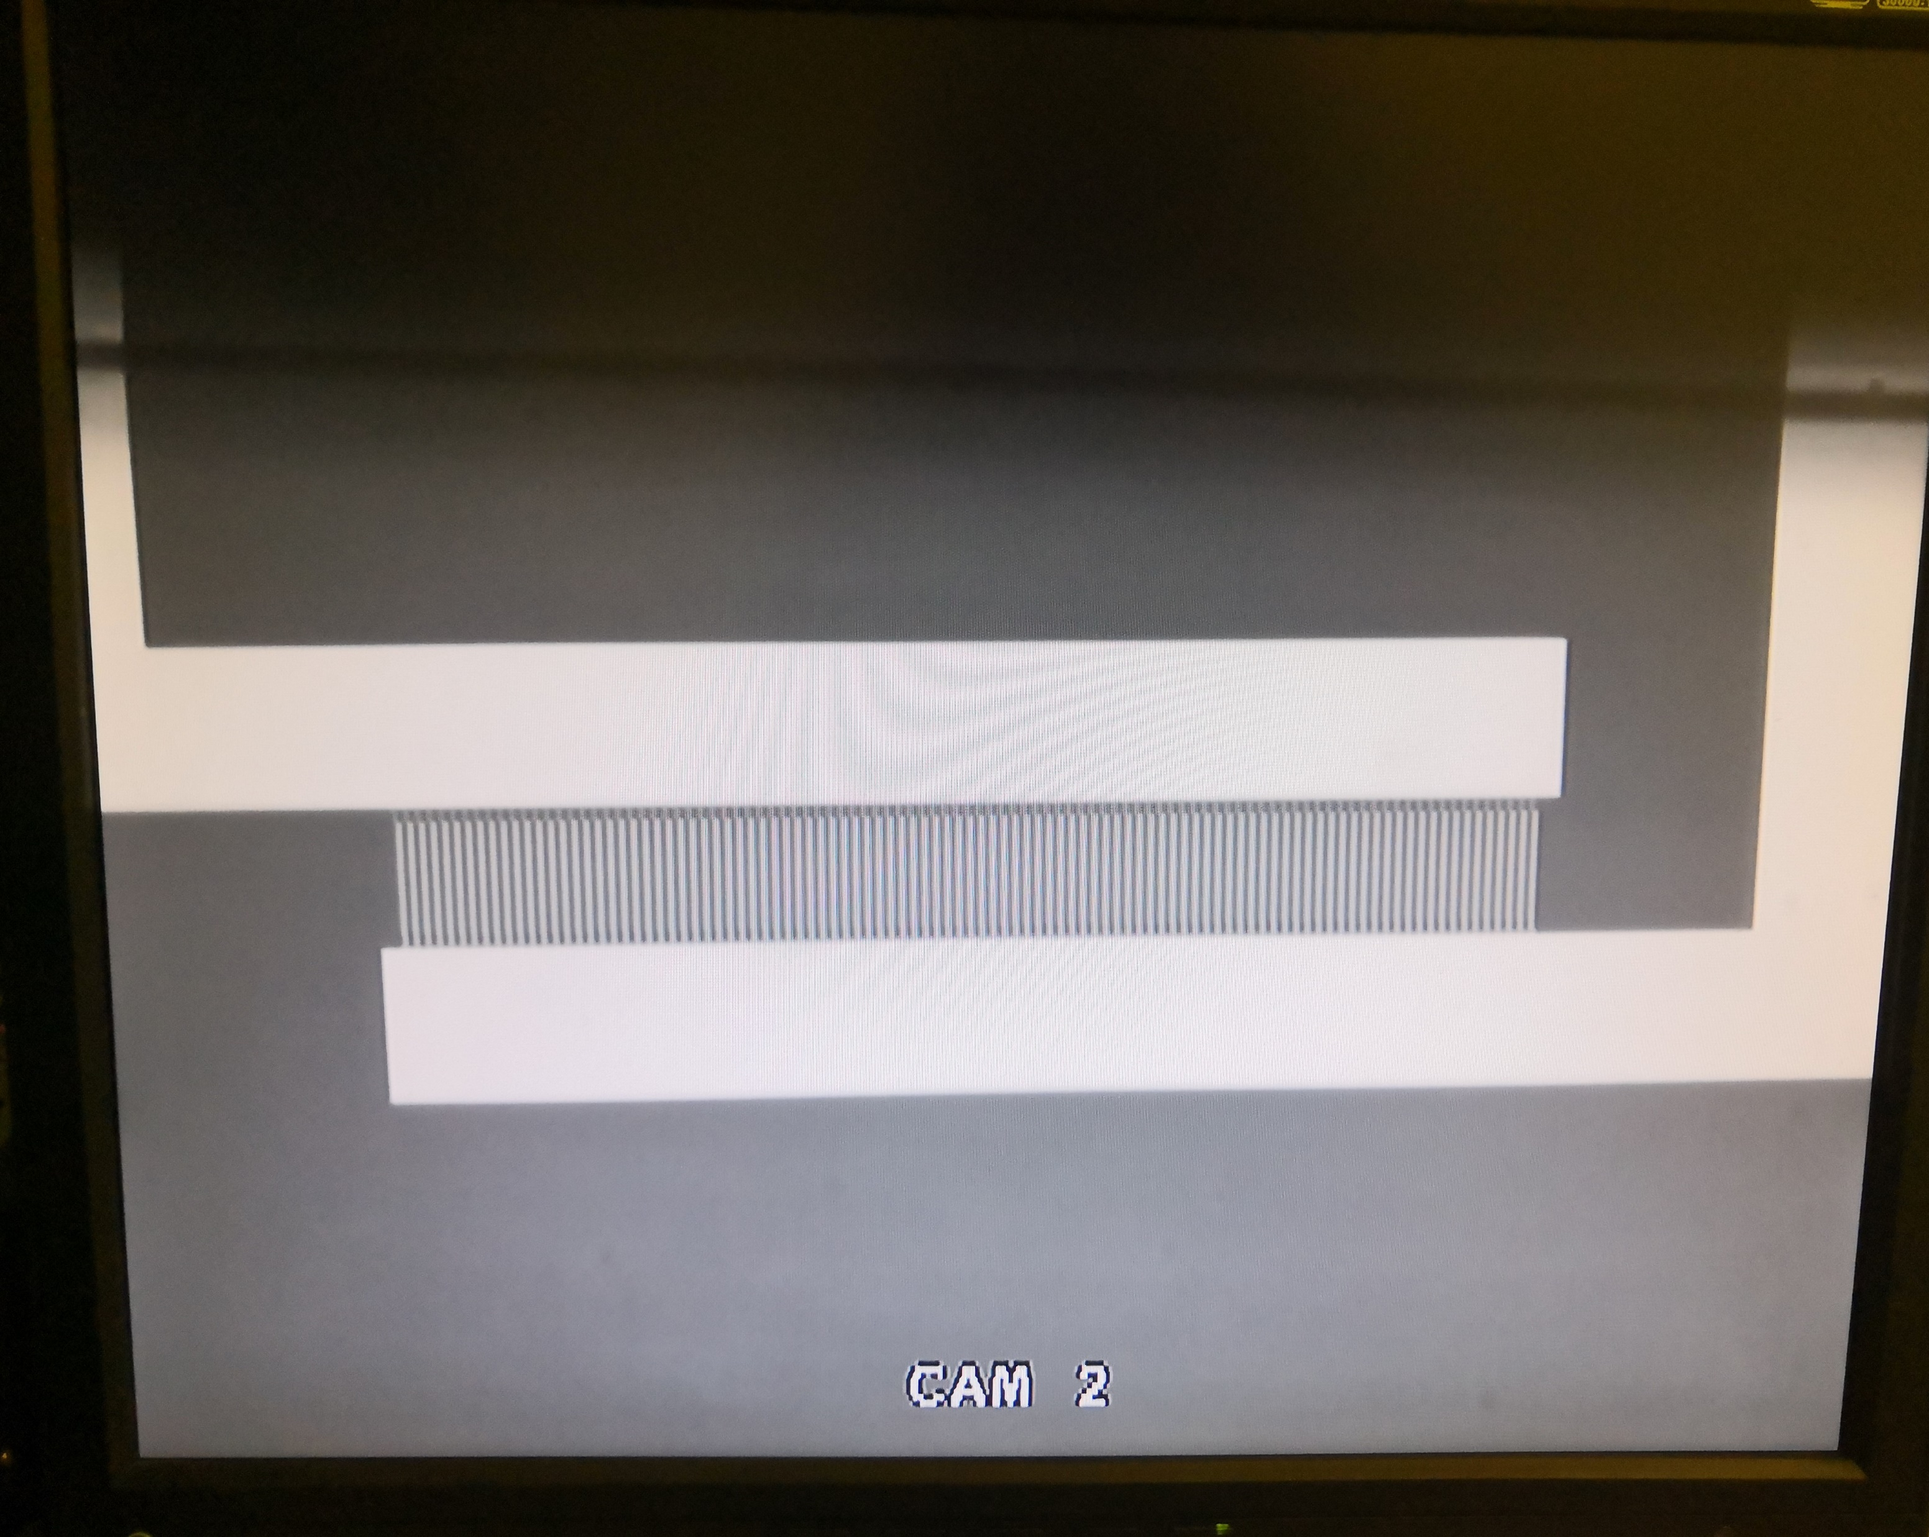
KLayout
Notes:
Mixed modeling

Slide 33

PyMTL3 Supplements
pytest ../regincr
-s --capture=no: generate a line trace for a test
--tb=short: produce more detailed error output (short)
--tb=long: produce more detailed error output (long)
--dump-vcd: generate (VCD) waveforms for a test
-v –-verbose: verbose output where each test case is listed on a separate line; passing test cases are marked with PASSED and failing test cases are marked with FAILED.
-k: select just a few test cases to run and debug in more detail
-x: have pytest stop after the very first failing test case
Options like –test-verilog requires verilator which is only available on Linux
Only pip install pymtl3 (and pytest) in Python virtual environments! Do not install in user directories like /home/<username>/pymtl3/lib/python3.10/site-packages/ or sudo install in root directories like /usr/local/lib/python3.10/dist-packages/ and /usr/local/bin. Follow the instruction on pymtl/pymtl3: Pymtl 3 (Mamba), an open-source Python-based hardware generation, simulation, and verification framework (github.com). pytest should be located at <venvname>/bin/pytest.
Notes:
Mixed modeling

Slide 34
PyMTL3 Supplements
Pay attention to the py.py file and the py module. PyMTL3 uses the py module in pymtl3/passes/sim/PrepareSimPass.py. In case the py module is name-conflicted with the <venvname>/lib/python3.10/site-packages/py.py file, you should delete the py.py file.
PyMTL3 officials require the specific version of verilator: Verilator 4.036, while the latest Verilator in the APT repository is Verilator 4.038 2020-07-11 rev v4.036-114-g0cd4a57ad. In most cases, this version works well, but if you encounter problems using this version, you should better build Verilator 4.036 from source. Besides, the build of Verilator 4.036 can also be problematic. See Bug#966909: Fixed upstream (mail-archive.com) and Fix build with Bison 3.7 and newer by rswarbrick · Pull Request #2505 · verilator/verilator (github.com). You should patch the fix manually or use Bison version < 3.7.
Notes:
Mixed modeling

Slide 35
Reference
Kexin Li and Yihua Liu. “Microfluidic robot with AC osmosis-based asymmetric electrode pair array fabricated by integrated circuit technologies.” Apr. 30, 2021.
Austin Rovinski, Tutu Ajayi, and Christopher Batten. “OpenROAD Tutorial: Open-Source ASIC Design for Computer Architects. Oct. 1, 2022.

